Slide 1

Introduction to Extensive Form Games (pt 1)
Chris Kiekintveld

Slide 2
Games with Sequential Moves
The normal form game representation does not incorporate any notion of sequence, or time, of the actions of the players
The extensive form is an alternative representation that makes the temporal structure explicit.
Two variants:
perfect information extensive-form games
imperfect-information extensive-form games

Slide 3
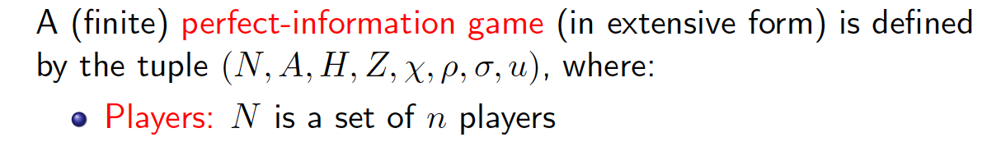
Definition

Slide 4
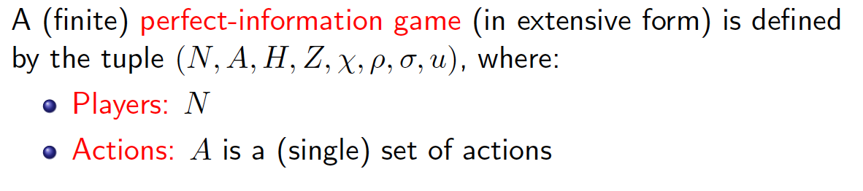
Definition

Slide 5
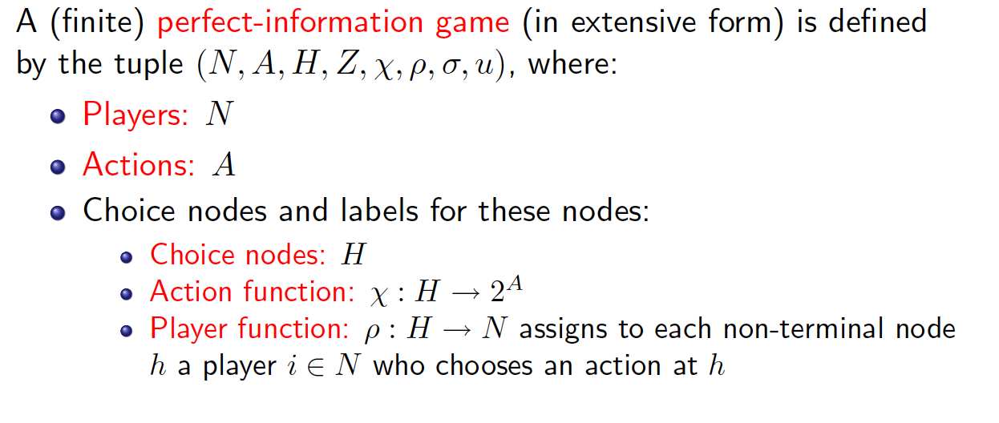
Definition

Slide 6
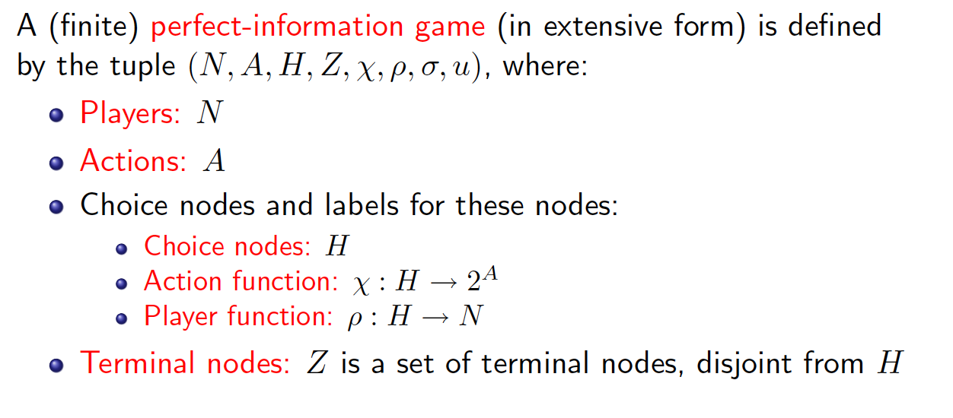
Definition

Slide 7
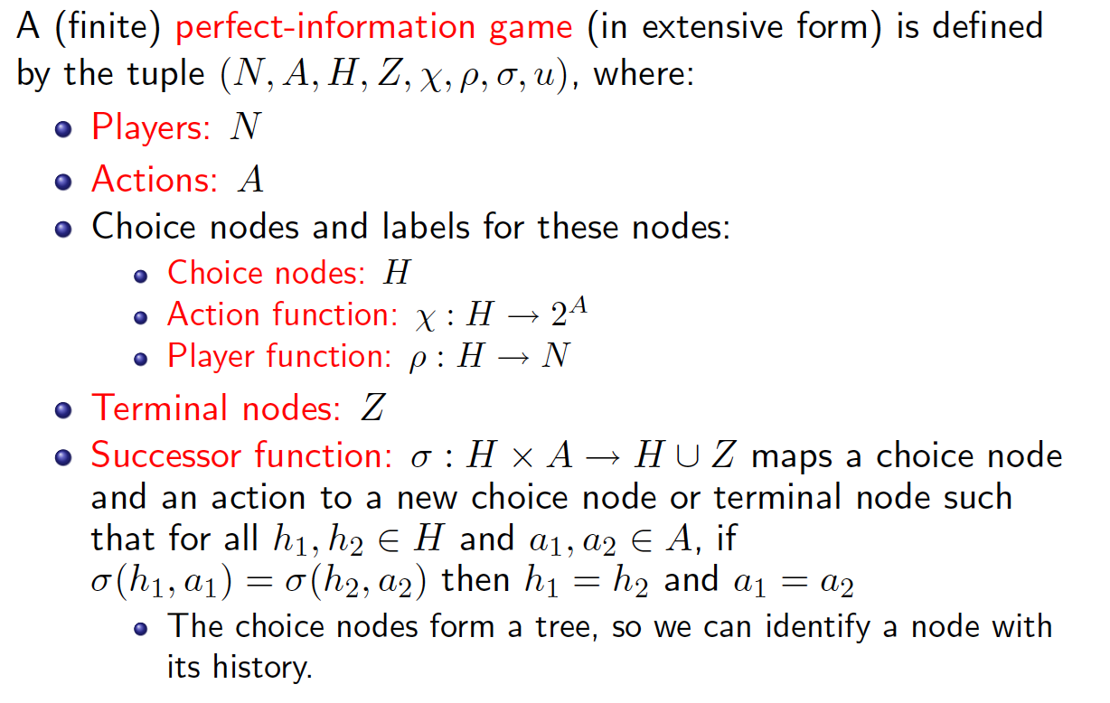
Definition

Slide 8
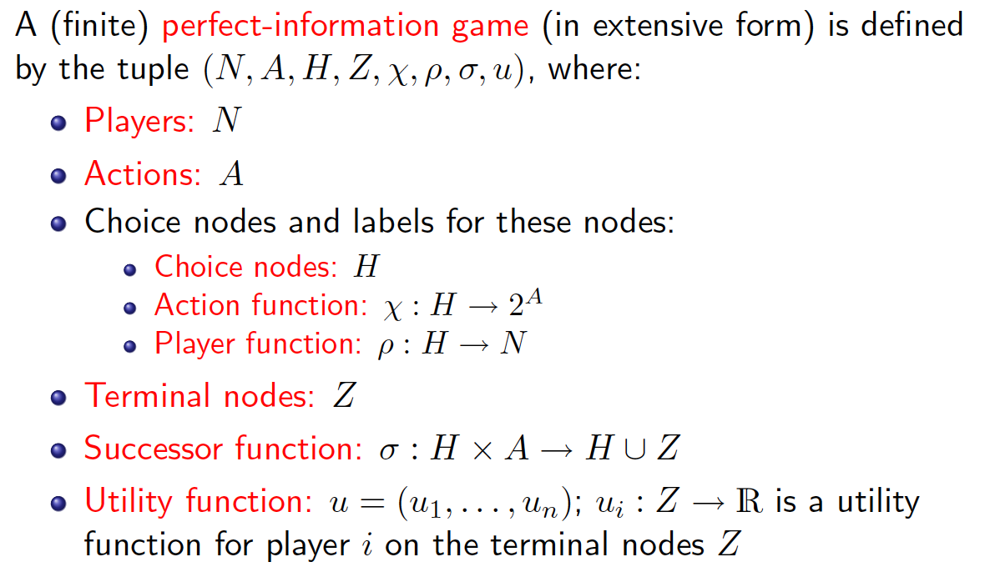
Definition

Slide 9
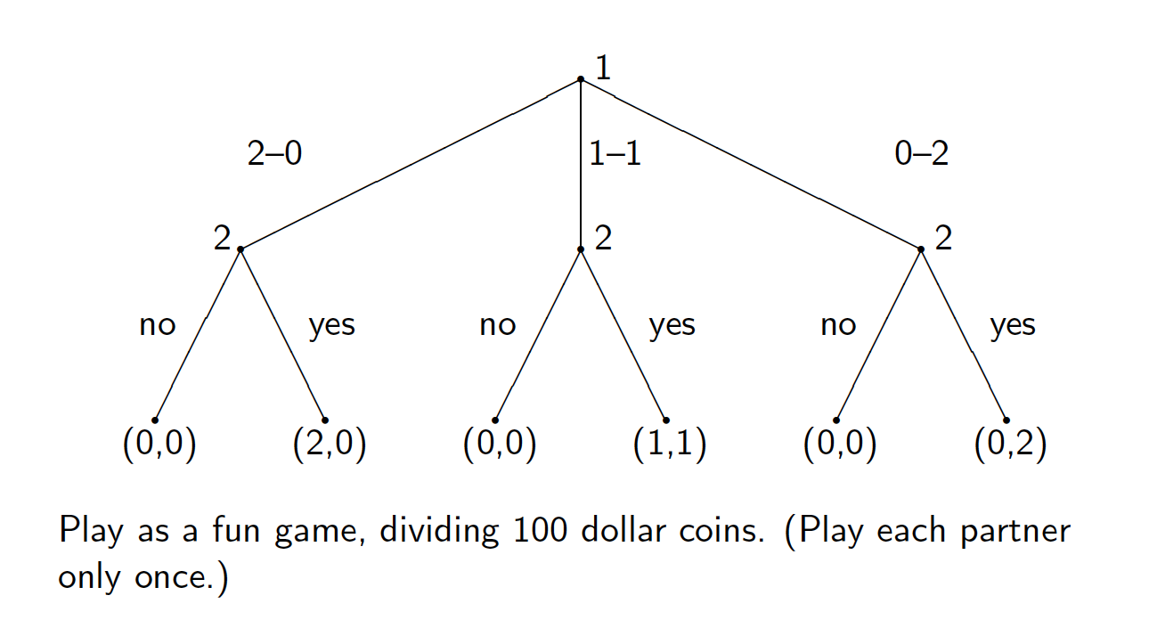
Example: Sharing Game

